Slide 2
The Direction of Intention
My God, give me the grace to perform this action with you and through love for you. In advance, I offer to you all the good that I will do and accept all the difficulty I may meet therein.
St. Ann, Pray for us.
St. Francis de Sales, Pray for us.

Slide 3
Overview
June 5: Introduction to the Book of Psalms
June 12: Psalms of Praise
June 19: Psalms of Lamentation
June 26: No Session
July 3: No Session
July 10: Psalms of Thanksgiving Royal Psalms and Psalms of Wisdom
July 17: The Theology of the Psalms
July 24: Learning to Pray the Psalms –
Liturgy of the Hours

Slide 4
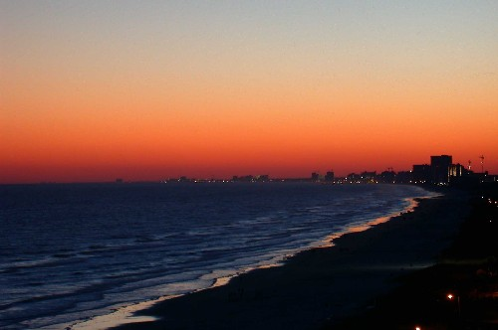
Thanksgiving:
A Thanks – Offering
Expression of Gratitude

Slide 5
Sitz im Leben
Sitz im Volksleben - "setting in the life of the people“
EX: "eeny, meeny, miny, moe..." When we hear this we know exactly what is happening.
Describes what occasions certain passages in the Bible were written for, and is often called the "genres“
Psalms 18; 30; 32; 34; 40; 41; 66; 92; 100; 107; 116; 118; 138

Slide 6
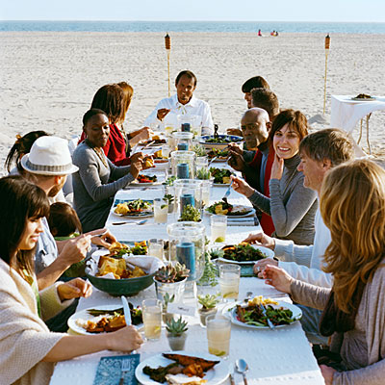
Psalms of Praise / Thanksgiving
These two psalms may sound similar when we read them
Psalms of Praise – Praise God for who God is
Psalms of Thanksgiving – Thank God for what he does
Many of the Psalms of Lament also thank God
The emphasis of these psalms is express grief, rage, despair….

Slide 7
Psalms of Thanksgiving
Thanksgiving:
An expanded Introduction, declaring the intention to thank God.
Narration of the trouble, usually to the guests of the celebration. The psalmist usually recounts:
his trouble (thus they are akin to Laments)
his calling upon God
his deliverance
Acknowledgement/proclamation of God’s deliverance; usually directed towards others.
Generally the psalm ends with an announcement of the thank-offering.
Read Psalm 138

Slide 8
Psalms of Thanksgiving
Both Individual and Communal
Individual – 9/10, 30, 32, 34, 41, 92, 116, 138
Communal (Liturgical) 65, 66, 67, 68 75, 107, 118, 124
Psalm 116

Slide 9
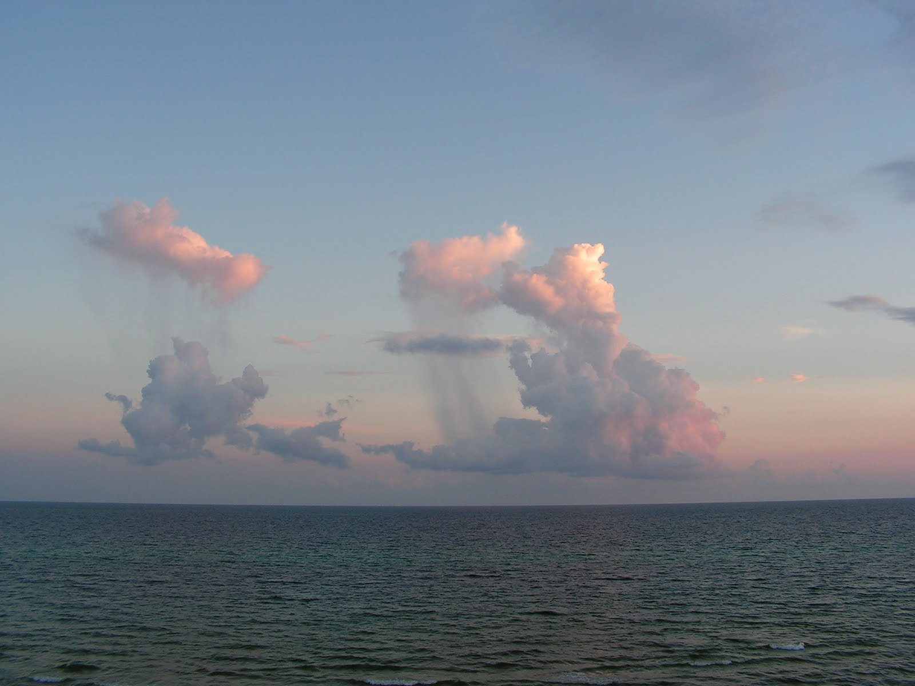
Royal Psalms
Deal with the spiritual role of kings in the worship of God
Comprised of Psalms of Praise, Lament and Thanksgiving

Slide 10
The Royal Psalms
Scholars often refer to some of the psalms as "royal" psalms. Royal Psalms always speak about the KING
Psalms 2, 18, 20, 21, 45, 72, 101, 110, 132, 144
These psalms are not all of one literary type, such as prayers of lament, petition and thanksgiving
Royal Psalms are linked thematically by their emphasis on how God works through the office of king.
In Old Testament – Most refer to Kind David or Solomon
Christian Scholars have linked these psalms with Jesus – The Messiah
Royal Psalms used during the Advent Christmas Cycle of Readings
Psalm 72 – Royal Psalm of Thanksgiving

Slide 11
Psalms of Wisdom
Why are these Psalms different?
Differ in Content and Style
Meant to instruct as opposed to evoke a response
Concerned with the problem of evil, the suffering of the righteous and the Justice of God

Slide 12
Psalms of Wisdom
Psalm 1, 37, 49, 73, 112, 119, 127, 128
The similarity to the genre of wisdom literature found in Proverbs, Job, Song of Songs and Ecclesiastes
The importance of getting wisdom - Hakam
means to live life skillfully.
Wisdom has to do with living life consistent with God's covenant.
Wisdom literature is very focused on the 'here and now'
Living the covenant NOW – Present Moment
Dependence on God

Slide 13
How to succeed amongst ungodly people – Psalm 73
The Ungodly
Can knock us for a loop (Ps.73)
They do pretty well for themselves (v.1,7,16,35)
They scheme against the weak (v.14)
They try to destroy the godly (v.12,14,32)
Don'ts
Envy (v.1, 16) b/c they will pass (v.2)
Fret (v.1,8)
Be persistently angry (v.8)
Do’s:
Place yourself in God's hands (v.3,5,7,23,28,33,34)
Delight yourself in God (v.4)
Do good where you are (v.3,21,27)
Absorb yourself in God's truth and let it guide your words & deeds (vv.30-31)

Slide 14
